Slide 1


Mahfuzul Hoque PhD
Professor
Department of Accounting & Information Systems
Faculty of Business Studies
University of Dhaka
mhoque71@gmail.com

Slide 2
WHAT IS A FEASIBILITY STUDY
A feasibility study is defined as an evaluation or analysis of the potential impact of a proposed project or program.
A feasibility study is conducted to assist decision-makers in determining whether or not to implement a particular project or program.
The study is based on extensive research on both the current practices & the proposed project/program & its impact on the current practice of the enterprise.
The feasibility study will contain wide-ranging of data related to financial & operational impact & will include advantages & disadvantages of both the current situation & the proposed plan.
The feasibility study is conducted during the deliberation phase of the business development cycle prior to commencement of a formal Business Plan. It is an analytical tool that includes recommendations & limitations, which are utilized to assist the decision-makers when determining if the Business Concept is viable (Drucker 1985; Hoagland & Williamson 2000; Thompson 2003c; Thompson 2003a).
DMH- Project Management

Slide 3
THE IMPORTANCE OF A BUSINESS FEASIBILITY STUDY
It is estimated that only one in fifty business ideas are actually commercially viable. Therefore, a Business Feasibility Study is an effective way to safeguard against wastage of further investment or resources (Gofton 1997; Bickerdyke et al. 2000).
If a project is seen to be feasible from the results of the study, the next logical step is to proceed with the full Business Plan. The research & information uncovered in the feasibility study will support the business planning stage & reduce the research time. Hence, the cost of the Business Plan will also be reduced.
A thorough viability analysis provides an abundance of information that is also necessary for the Business Plan. For example, a good market analysis is necessary in order to determine the business concept's feasibility. This information provides the basis for the market section of the Business Plan (Bangs 2000; Hoagland & Williamson 2000; Truitt 2002; Thompson 2003b).
DMH- Project Management

Slide 4
FEASIBILITY STUDY
A feasibility study should contain clear supporting evidence for its recommendations.
Recommendations will be reliant on a mix of numerical data with qualitative, experience-based documentation.
A Business Feasibility Study is heavily dependent on the market research & analysis.
A feasibility study provides the stake holders with varying degrees of evidence that a Business Concept will in fact be viable (Hoagland & Williamson 2000; Thompson 2003c; Thompson 2003a; Wickham 2004).
DMH- Project Management

Slide 5
FEASIBILITY STUDY
Identify
problem or
opportunity
Set up
feasibility
study
Define scope
and
objectives
Recommend –
proceed
Evaluate
alternatives –
develop/buy
Carry out
different
aspects
of the study
DMH- Project Management

Slide 6
BUSINESS FEASIBILITY STUDY AND DIMENSIONS OF BUSINESS VIABILITY
The Business Feasibility Study findings will be assessed by potential investors & stakeholders regarding their credibility & depth of argument.
The Business Feasibility Study places the findings of the Dimensions of Business Viability Model assessment into a formal business report. It also aligns the findings with functional processes of an enterprise which an audience can easily understand (Thompson 2003a).
DMH- Project Management

Slide 7
BUSINESS FEASIBILITY STUDY AND DIMENSIONS OF BUSINESS VIABILITY Contd.
  For the purposes of understanding the structure of a Business feasibility Study the following represents the framework of the Dimensions of Business Viability (Thompson 2003c; Thompson 2003a):
      Market Viability
      Technical Viability
      Business Model Viability
      Management Model Viability
      Economic & Financial Model Viability
      Exit Strategy Viability
Business & market analysis will contribute considerably to the Business Feasibility Study . Consideration should be given to using traditional business analysis techniques such as SWOT, Porters Five Forces & PEST. Although they may not provide information which is a perfect fit to the proposed business model, they will provide a strong starting point for future analysis.
DMH- Project Management

Slide 8
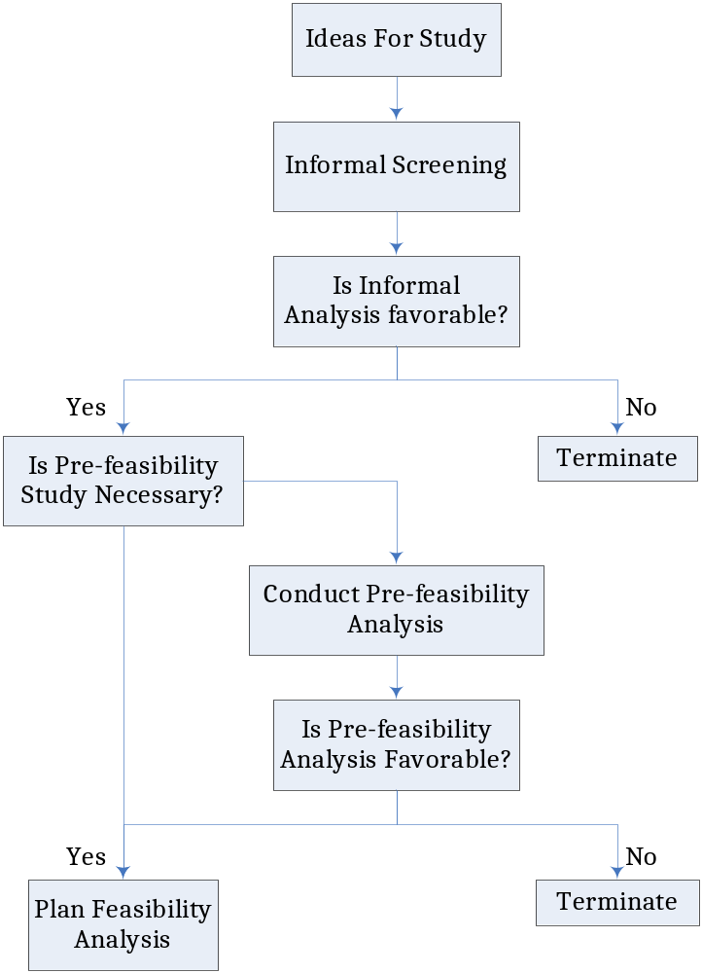
Identification & Pre-selection

Slide 9
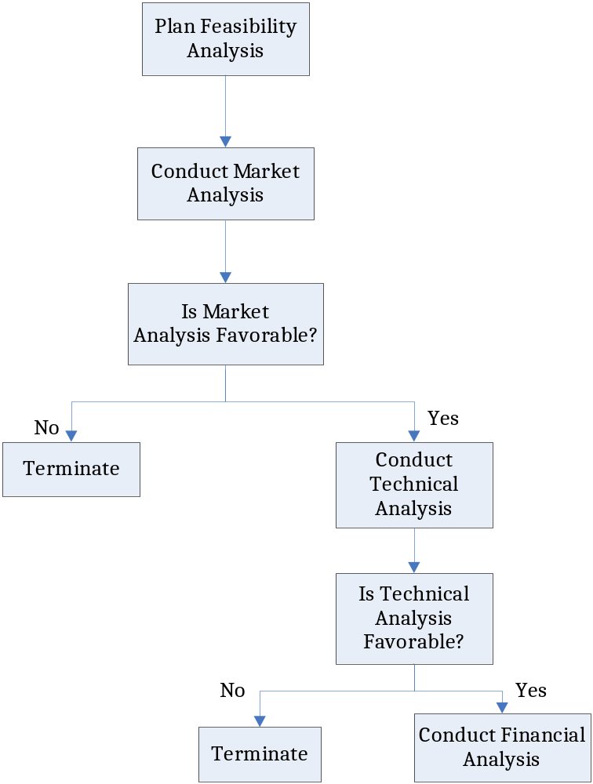
Analysis

Slide 10
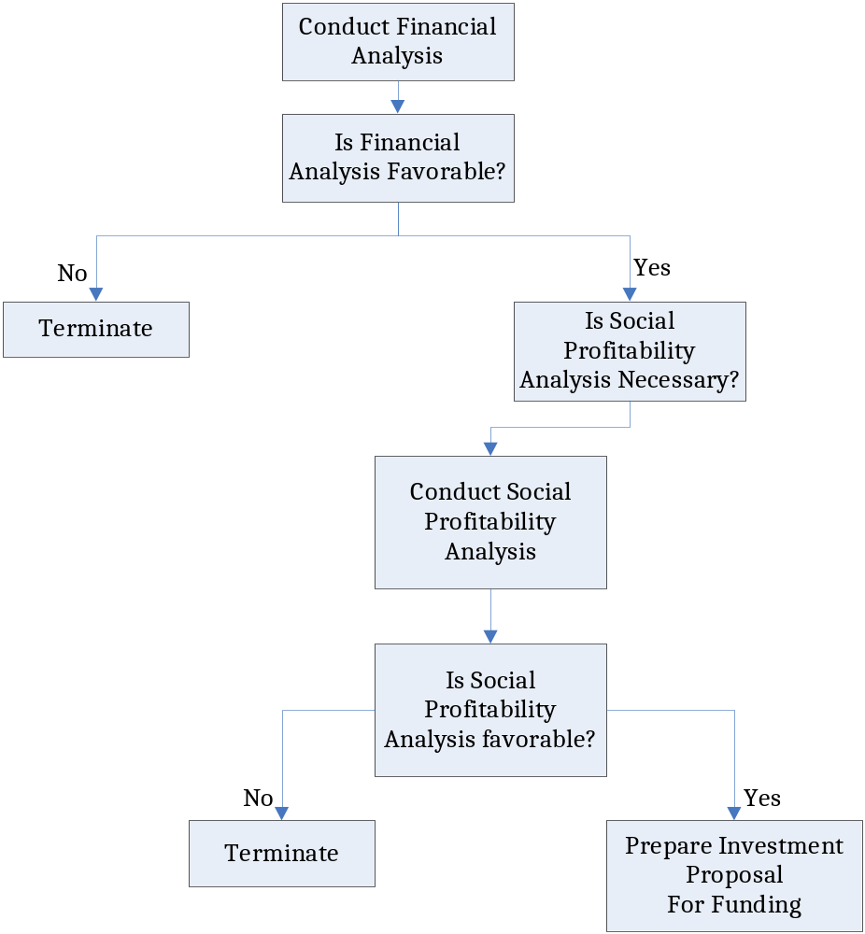
Evaluation

Slide 11
Typical Issues in Feasibility Study
Market Feasibility
Technical Feasibility
Resource Feasibility
Cultural Feasibility
Operational feasibility'
Legal Feasibility
Schedule Feasibility
Economic Feasibility
DMH- Project Management

Slide 12
Market Feasibility
A market assessment may be conducted first to identify market opportunities. If no opportunities exist, there may be no reason to proceed further.
  Industry description.
  Industry competitiveness.
  Market potential
  Access to market outlets.
  Sales projection

Slide 13
Technical Feasibility
This involves questions such as whether the technology needed for the project , how difficult it will be to operate, and whether the firm has enough experience using that technology. The assessment is based on an outline design of system requirements in terms of Input, Processes, Output, Fields, Programs, and Procedures. This can be quantified in terms of volumes of data, trends, frequency of updating, etc. in order to estimate if the new technology will perform adequately or not.
Technical Feasibility
  Determine facility needs.
  Suitability of production technology.
  Availability and suitable of site.
  Raw materials.
  Other inputs.

Slide 14
Resource Feasibility
This involves questions such as how much time is available to develop the project, when it can be develop, whether it interferes with normal business operations, type and amount of resources required, dependencies, etc. Contingency and mitigation plans should also be stated here so that if the project does over run the company is ready for this eventuality.

Slide 15
Cultural Feasibility
In this stage, the project's alternatives are evaluated for their impact on the local and general culture. For example, environmental factors need to be considered and this factors are to be well known. Further an enterprise's own culture can clash with the results of the project.

Slide 16
Operational feasibility'
Do the current work practices and procedures support a new system required by the project. Also social factors i.e. how the organizational changes will affect the working lives of those affected by the new system..

Slide 17
Legal Feasibility
Determines whether the proposed project conflicts with legal requirements, e.g. a Data Processing system must comply with the local Data Protection Acts. When an organization has either internal or external legal counsel, such reviews are typically standard. However, a project may face legal issues after completion if this factor is not considered at this stage. it is about the authorization.

Slide 18
Schedule Feasibility
A project will fail if it takes too long to be completed before it is useful. Typically this means estimating how long the system will take to develop, and if it can be completed in a given time period using some methods like payback period.

Slide 19
Economic Feasibility
Economic analysis is the most frequently used method for evaluating the effectiveness of a candidate project. More commonly known as cost/benefit analysis, the procedure is to determine the benefits and savings that are expected from a candidate project and compare them with costs. if benefits outweigh costs, then the decision is made to design and implement the project.

Slide 20
BUSINESS FEASIBILITY STUDY OUTLINE
Because putting together a Business Plan is a significant investment of time & money, the entrepreneur should make sure that there are no major roadblocks on their road to business success. The Business Feasibility Study will assist in identifying such obstacles & determine the true viability of the Business Concept. The following represents a structural outline for a Business Feasibility Study:
DMH- Project Management

Slide 21
The following represents a structural outline for a Business Feasibility Study:
Executive Summary
Table of Contents
Introduction
Product or Service
Technology
Market Environment
Competition
Industry
Business Model
Marketing & Sales Strategy
Production/Operating Requirements
Management & Personnel Requirements
Intellectual Property
Regulations/Environmental Issues
Critical Risk Factors
DMH- Project Management

Slide 22
EXECUTIVE SUMMARY
The Executive Summary is a summary of all key sections of the Business Feasibility Study & should work as a separate, standalone document. Interested parties will read this section first in conjunction with a glance at the financial section when deciding whether or not they read the rest of the plan. Key points to remember include:
Write this document after the content section of Business Feasibility Study is completed.
Although the Executive Summary is written last, it is presented first.
The Executive Summary should be no more than one page long.
DMH- Project Management

Slide 23
PRODUCT/SERVICE
Describe the enterprises, product or service in simple language. Give product mix if the enterprise will initially be focusing on more than one product.
Describe how customers would use & buy the product or service. Give enough detail to help the reader judge the effectiveness of your marketing & positioning plans.
Describe key components or raw materials that will be used in the product, how the enterprise will source these & how available they are.
Describe plans to test the product to ensure it works as planned & is sufficiently durable, rugged, secure, etc. (e.g. consumer product test, beta test with major company, etc.).
Describe plans to upgrade product or expand product line.
DMH- Project Management

Slide 24
TECHNOLOGY
As necessary, provide further technical information about the product or service.
Describe additional or ongoing research & development needs.
Keep the description in lay terms and/or explain technical terms enough to be understood by business-savvy but not necessarily technology expert readers.
DMH- Project Management

Slide 25
INTENDED MARKET ENVIRONMENT
Target Market:
  Define & describe the target market(s). Distinguish between end users & customers.
  Be clear how end users & customers benefit. How & why would they buy the product or service?
  What is the projected need(s) your product or services fulfill so beautifully? How big is the opportunity? What level of actual market demand can be measured versus projected?
DMH- Project Management

Slide 26
INTENDED MARKET ENVIRONMENT Contd.
For business-to-business markets, include:
  What industry is the target market in, who are the key players, frequency of product purchase, replacement needs versus expansion, purchasing process
  Estimates of market size, initial targeted geographic area, enterprise’s targeted market share.
For business-to-consumer markets, include:
  Demographic factors, such as income level, age range, gender, educational level, ethnicity.
  Psychographic factors.
  Relevant behavioural factors such as frequency of product purchase & shopping behaviour.
DMH- Project Management

Slide 27
COMPETITION
Describe direct & indirect competition (as it pertains to the target markets only).
For key competitors, give market share, resources, product & market focus, goals, strategies, strengths & weaknesses.
List all key barriers to entry.
Describe what is unique about the enterprise’s product/service compared to the competition. Make sure this is consistent with the unmet need of the target market(s).
State how difficult it will be for competitors to copy the enterprise’s product/service.
Describe how competitors will most likely react to the enterprise’s product launch & the enterprise’s response strategy. Include estimates of the time it might take a competitor to copy your product or service.
DMH- Project Management

Slide 28
INDUSTRY
Clearly define & describe the industry in which the enterprise operates. Include the size, growth rate, & outlook. Define key industry segments & state where enterprise fits in.
Describe demand & supply factors & trends.
Describe the larger forces that drive the market - e.g. innovation, cultural change, regulation, whatever.
DMH- Project Management

Slide 29
BUSINESS MODEL
Describe the proposed enterprise's business model. How will the business generate revenue (i.e. sell the product; charge licensing, retail sales)? Will there be recurring revenue?
Describe the model in enough detail to support financial projections presented later.
DMH- Project Management

Slide 30
MARKETING AND SALES STRATEGY
Lay out the basic marketing & sales strategies.
Discuss any strategic partnership the enterprise has or is planning to form. Do they provide critical market access or other resources? What are their rights & responsibilities?
Describe the distribution strategy (sell direct to customers through sales force, direct mail, or Internet; sell through manufacturers’ representatives, wholesalers, distributors, or retailers). Provide projected profit margin or mark-up expectations, commissions, & other expected compensation (co-op advertising, slotting fees, etc.)
DMH- Project Management

Slide 31
MARKETING AND SALES STRATEGY Contd.
Describe the pricing strategy & justification. Include the expected gross profit margins.
Describe intended typical payment terms for customers.
Ot her issu esand their imp act - e. g. , warranties.
Quantify the marketing budget for at least the first year (ideally three).
DMH- Project Management

Slide 32
PRODUCTION/OPERATING REQUIREMENTS
Describe enough of how & where the enterprise will manufacture, source or create & deliver the final product or service to be able to estimate costs.
What physical premises are required? Give location, size, age, condition, & capacity of planned production & warehouse facilities & number of shifts planned.
Will space be owned or leased? Will renovations be required? At what cost?
How complex is the manufacturing process?
Describe equipment needed & costs.
DMH- Project Management

Slide 33
PRODUCTION/OPERATING REQUIREMENTS Contd.
If enterprise will outsource production or distribute others’ materials:
Describe supply sources. Are sources of supply readily available?
Outline the relevant contract terms, manufacturer’s capacity, minimum order & tooling requirements, reputation, size or financial condition.
Describe the enterprise’s plan to protect its proprietary processes & trade secrets & quality control.
If enterprise is providing a service:
How will the service be designed, delivered, measured & improved?
What stakeholders exist, who will be trading partners with the business? What will be the terms of the contract? Are there substitute partners?
DMH- Project Management

Slide 34
MANAGEMENT AND PERSONNEL
List the proposed key managers, titles, responsibilities, relevant background, experience, skills, costs.
Sketch personnel requirements: what people will be needed now, in a year, in the long term? What skills & qualifications are required & what financial implications result?
DMH- Project Management

Slide 35
INTELLECTUAL PROPERTY
Briefly describe patents, copyrights, & trademarks obtained & in process. Give all names that are on issued patents; summarize results of patent searches.
If enterprise is operating under a licensing agreement or patent assignment, give name of licensor/assignor, describe key terms (e.g. exclusivity, rights & responsibilities), & give termination or renewal date.
DMH- Project Management

Slide 36
INTELLECTUAL PROPERTY Contd.
If the business concept is a science (research orientated) business, the intellectual property is extremely important. The protocols in managing them, particularly at the initial planning stage are critical. For example, if a researcher has published their research findings in an industry journal or on the internet prior to ensuring intellectual ownership through copyright or patent, then the knowledge is considered in the open domain & therefore cannot be considered restricted.
Often business planning associated with intellectual property must occur prior to a business (science – research & development) concept being developed & validated so that the strength & ownership of the findings can be assured.
DMH- Project Management

Slide 37
REGULATIONS/ENVIRONMENTAL ISSUES
Outline non-economic forces that might affect the prospects of the firm:
Key government regulations & the enterprise’s plans for compliance.
Any environmental problems on property, plans to address the problems, & their cost.
Environmental factors i.e. waste disposal plans, if needed.
Political stability, if applicable.
Any other regulatory or political issues. This may deal with proposed industry regulatory changes, stable versus unstable environments.
DMH- Project Management

Slide 38
CRITICAL RISK FACTORS
Describe critical risks faced by the enterprise (currently or in the future). Much of these components will arise from the SWOT, Porters Five Forces & PEST analysis.
Examples include internal characteristics, uniqueness, investment, economic forecasts, change in regulations & technical obsolescence, etc. Be sure to describe how you will mitigate each risk.
DMH- Project Management

Slide 39
START-UP SCHEDULE
Sketch the major events in the life of the venture by listing the timetable/deadlines for completion of phases of venture start-up. Be sure to demonstrate the relationship of events & to keep the mile stones, Financial requirements, personnel requirements, etc. consistent. If establish a formal project schedule for the start-up process.
DMH- Project Management

Slide 40
FINANCIAL PROJECTIONS
Include a narrative highlighting key underlying assumptions & the logic governing your projections. Include financial history, if any (e.g. equity & debt), & likely financing stages including information about funding sources & uses. Provide a page or two of footnotes for each financial spreadsheet attached explaining the assumptions behind each major line item. Some core components of this part of the report are listed below.
DMH- Project Management

Slide 41
FINANCIAL PROJECTIONS Contd.
The Structure of the Financial Projections includes the following:
Balance Sheet Projections
Income Statement Projections
Cash Flow Projections
Break-even Analysis
Capital Requirements & Strategy
Recommendations & Findings
Conclusion
DMH- Project Management

Slide 42
FINANCIAL PROJECTIONS Contd.
Balance Sheet Projections - Three Years & Highlight Inflows of Capital,
Income Projections - Year 1: Monthly or quarterly; years 2 & 3: Annually,
Cash Flow Projections - Year 1: Monthly or quarterly; Years 2 & 3: Annually,
Break-Even Analysis - When will the firm begin to turn a profit, &
Cost Benefit Analysis - Will the business provide a viable return on investment for the owner and/or the investors.
DMH- Project Management

Slide 43
CAPITAL REQUIREMENTS & STRATEGY
How much funding (equity) will the firm need, & when?
What projected revenue or assets does the proposed business have to secure the financing?
What sources will provide the funding, i.e. investors, lending institutions etc?
What ratio of debt to equity financing will occur?
When will investors begin to see a return? What is the expected return on investment (ROI)?
DMH- Project Management

Slide 44
HOW TO CONDUCT A BREAK EVEN ANALYSIS
The entrepreneur will need to understand the following terms in order to understand & communicate the break-even analysis:
Selling Price (SP) - Represents the price that each unit will sell or retail for. The SP is generally expressed as revenue in dollars per unit.
Variable Costs (VC) - Consist of costs that vary in proportion to sales levels. They include direct material & labor costs, the variable part of manufacturing operating cost, transportation & sales expenses. The VC is usually expressed as a cost in dollars per unit.
Contribution Margin (CM) - Equal to sales revenues less variable costs or SP - VC.
DMH- Project Management

Slide 45
HOW TO CONDUCT A BREAK EVEN ANALYSIS Contd.
Fixed Costs (FC) - These costs are considered those that remain constant within the projected range of sales levels. These can include facilities costs, general & administrative costs, capital interest & depreciation expenses. The FC is usually expressed as a lump-sum cost in dollars.
Units (X) - Represents the number of items sold or produced. For the purpose of a break-even calculation, it is assumed that the number of units sold during a period is equal to the number of units produced during the same period.
DMH- Project Management

Slide 46
HOW TO CONDUCT A BREAK EVEN ANALYSIS Contd.
To calculate break-even, the entrepreneur should determine the variables: FC, SP, & VC. The process of separating the selling price & variable costs is not always straight forward & alternatively a contribution margin is given. The CM can still be used in the break-even calculation, replacing the SP & VC.
To calculate the number of units sold ( or produced ) at breakeven.
SP(X) = VC(X) + FC
Alternatively the formula to solve for X, the number of units at break-even will give you:
X = FC / (SP - VC) or X = FC / CM
The formula to calculate the break-even revenue in $ is as follows:
Break-even revenue ($) = Break-even units x Selling Price
DMH- Project Management

Slide 47
FINAL FINDINGS & RECOMMENDATIONS
Recommendations from the feasibility study regarding the viability of putting the business idea into practice should be honest, short & direct. When making the findings or recommendations arising from the Business Feasibility Study discussing the viability of the proposed business venture in terms of:
    Market Viability
    Technical Viability
    Business Model Viability
    Management Model Viability
    Economic & Financial Model Viability
    Exit Strategy Viability
DMH- Project Management

Slide 48
FINAL FINDINGS & RECOMMENDATIONS Contd.
A significant component of the findings should related to the likelihood of success, projected return on investment & how any identified risk should be mitigated.
The purpose of the feasibility study is to consolidate an argument based on factual evidence & analysis to help justify your decision in relation to the core question of whether the business venture in questions is actually viable.
DMH- Project Management

Slide 49
SOURCES OF HELP
To write the Feasibility Study, you need to go to others for help & information. Look at recent history to demonstrate the best approach or business model. Suggested sources are:
Business Enterprise Centers – Information, business counseling, training workshops, research facilities, back up & support facilities, networking & publications.
Accountant - Advice on all financial issues, assist in feasibility study, legal structure suggestions, assist in funding estimates, sourcing & applications, check books if buying an existing business.
Solicitor - Contracts , leases , legal representation.
Bank - Finance, information & support, leasing, advice on contracts, specialist services.
Business Advisers/Consultants - Someone to talk to, specialist advice, mentoring, negotiations, training, back-up.
DMH- Project Management

Slide 50
SOURCES OF HELP Contd.
Trade Associations - Membership & support, group deals, training, advice, research, industrial relations expertise, & networking.
Potential Suppliers - Information, back up, promotional support, training, etc.
Sources of Information - Own research, government departments, information and publications available from many departments including the Australian Bureau of Statistics. Local council demographic reports, publications, studies and future plans for development.
Competitors - Check the competition, their location, layout, advertising and service.
University Libraries and Online Entrepreneurship Resources
DMH- Project Management

Slide 51
NOTE:
Remember a Business Feasibility Study supports the decision-making process as to whether the Business Concept is in fact viable.
A No Viability answer is still a positive result as it saves the entrepreneur wasting financial resources and valuable time.
The Business Feasibility Study outline and the Business Plan outline are very similar in nature and are normally designed to dovetail in pursuit of efficiencies of development, evidentiary alignment and consistency of reporting.
DMH- Project Management

Slide 52
REFERENCES
Bangs, D. (2000). The Australian Business Planning Guide. Warriewood, Woodslane Pty Ltd.
Bickerdyke, I., Lattimore, R. and Madge, A. (2000). Business Failure and Change: An Australian Perspective. Canberra, Productivity Commission Research Paper.
Drucker, P. F. (1985). Innovation & Entrepreneurship. New York, HarperTrade.
Gofton, L. (1997). Business Market Research. London, Kogan Page.
Hoagland, H. and Williamson, L. (2000). Feasibility Studies. Kentucky, University of Kentucky.
Thompson, A. (2003a). Business Feasibility Studies: Dimensions of Business Viability. Perth, Best Entrepreneur.
Thompson, A. (2003b). Overview of a Business Plan. Perth, Best Entrepreneur.
Thompson, A. (2003c). Understanding the Proof of Business Concept. Perth, Best Entrepreneur.
Truitt, W. (2002). Business Planning: A Comprehensive Framework and Process. London, Quorum Books.
Wickham, P. (2004). Strategic Entrepreneurship. Essex, Pearson Education.
DMH- Project Management

Slide 53
DMH- Project Management

